Slide 1

Ad-hoc Report
By: Piyush Tikiya

Slide 2
Dim_city
all cities in Bharat Herald’s operational scope. Used to link other fact tables, classify cities by tier, and perform location-based segmentation.
Dim_Ad_Category
Normalizes inconsistent ad category entries from fact_ad_revenue. Also maps categories to sector groups and brand examples to enrich ad analysis.
Fact_print_sales
Captures monthly print performance of Bharat Herald across cities. Tracks how many copies were printed, sold, and finally circulated—essential for evaluating print demand and operational efficiency.
Tracks quarterly ad revenues by city and category. Useful for analyzing ad market trends, city-level engagement by advertisers, and category-level ad investments over time.
Fact_Ad_Revenue
Details Bharat Herald’s short-lived digital pilot during 2021. Helps evaluate the feasibility, cost, and impact of digital transformation efforts.
Fact_digital_pilot
Fact_city_readiness
Provides dynamic, time-based readiness scores for each city using three factors—literacy rate, smartphone penetration, and internet penetration. Important for modeling digital adoption potential across regions.

Slide 3
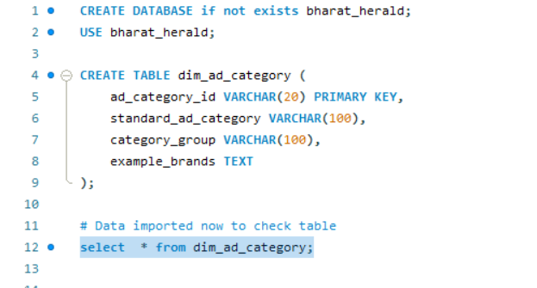
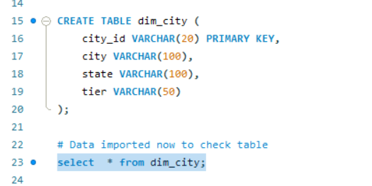
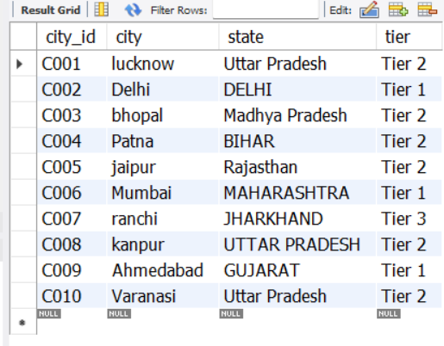
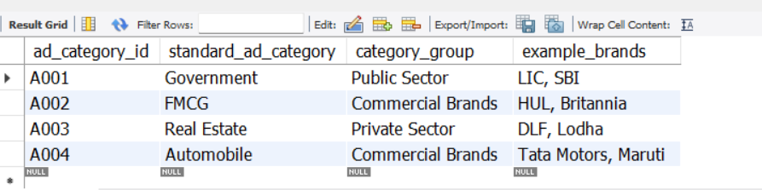
Table- 1
Table- 2

Slide 4
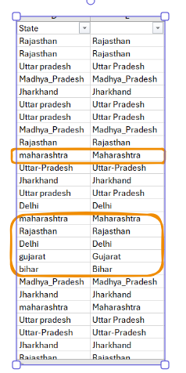
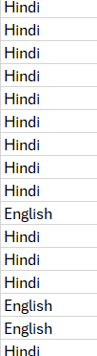
Transformation| Cleaning
While importing the fact_ad_revenue data I noticed the quarter column contains many unequal format like : Q1-2022, 2020-Q1, 4TH OF QTR 2024. SO, I made them uniform so that data look equal, cleaner and easy to extract. Same way, currency column contains currency type USD, EUR, IN RUPEE which I made them to “INR” to make data standardise.
Same way, The State and Language column in the fact_print_sales table is not properly formatted, so I standardized the first letter of each state & Language column to ensure consistency.
CityID column contains two format
C-010
C-10
So, I have done C-10 to C-010
Edition_Id contains ED1010 and ED110 so I validate those from Fact_ad_revenue where no such ED110 EXISTS THEN I MADE THEM REPLACE WITH ED1010

Slide 5
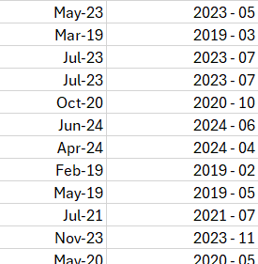
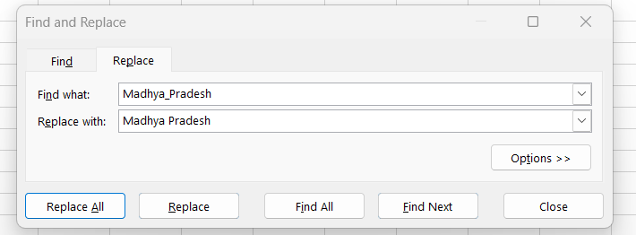
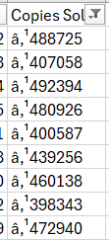
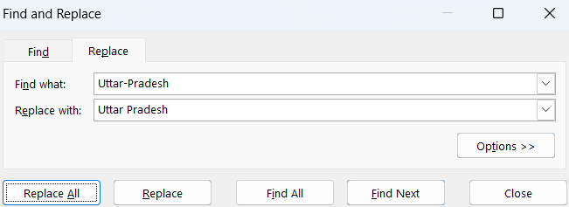




The Month column in the fact_print_sales table is not properly formatted, so I standardized Dates May-23 to 2023-05(yyyy-mm)
The Copies Sold column in the fact_print_sales table is not properly formatted, so I standardized column by removing to 488725.

Slide 6
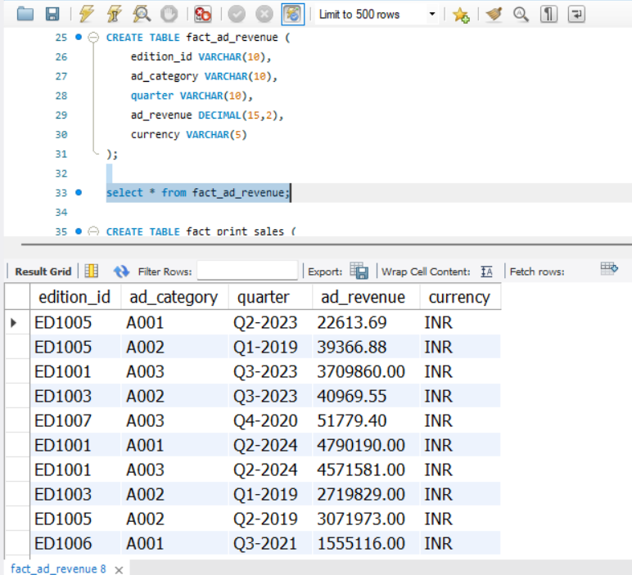
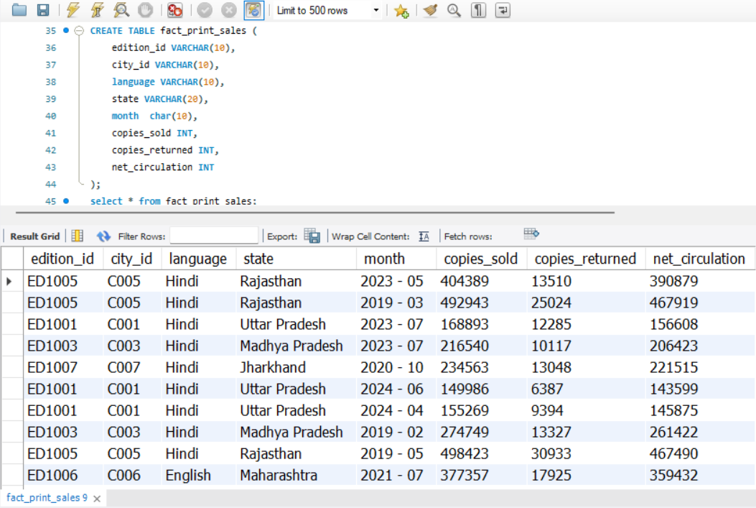
Table- 4
Table- 3

Slide 7
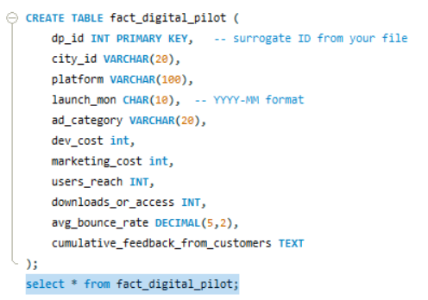
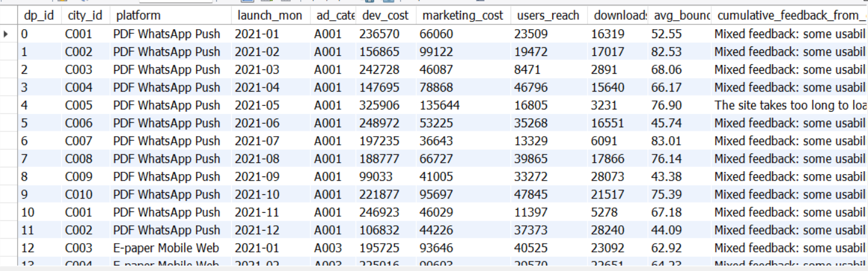
Table- 5

Slide 8
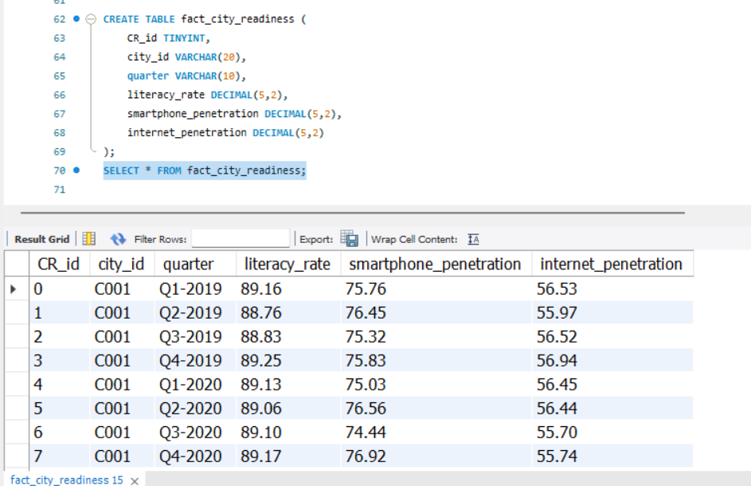
Table- 6

Slide 9
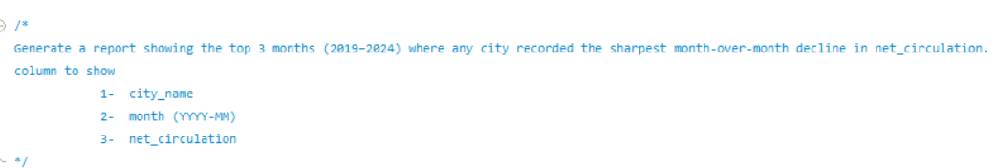
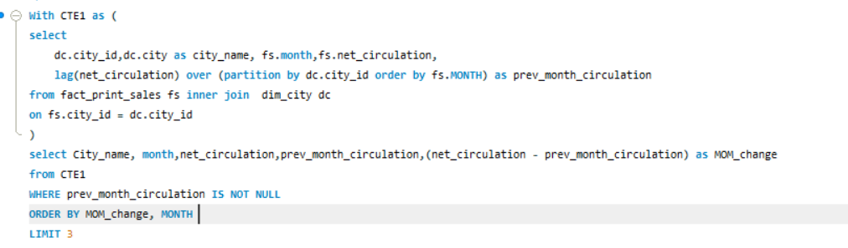
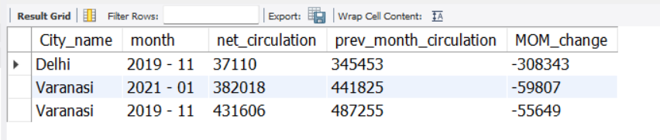
Business Request - 1

Slide 10
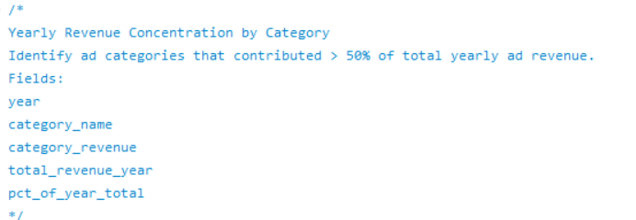
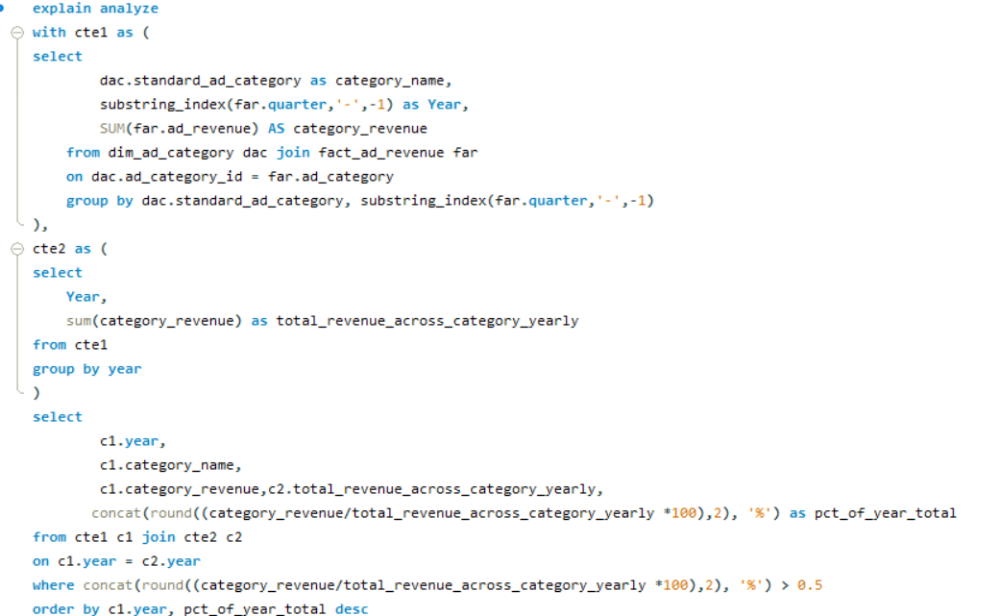
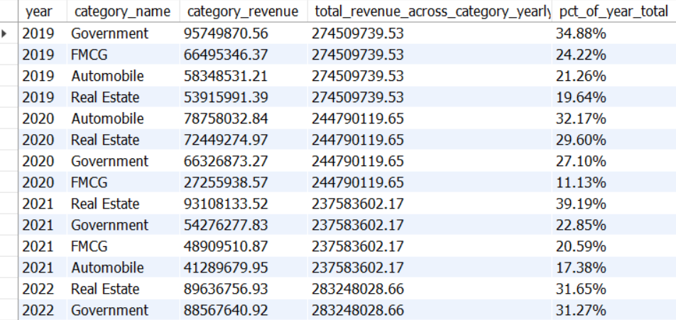
Business Request – 2

Slide 11
2019
2020
2021
2022
2024
2023

Slide 12
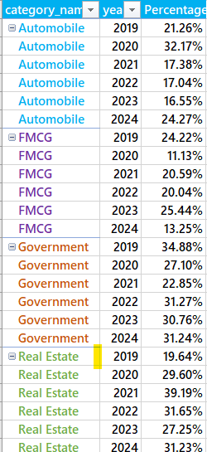
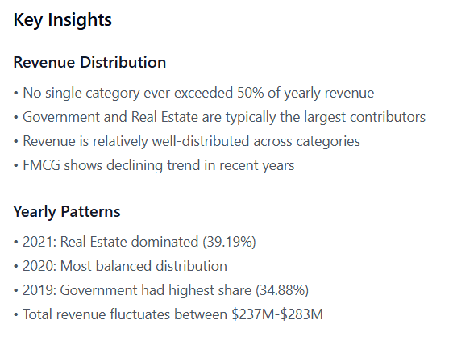

Slide 13
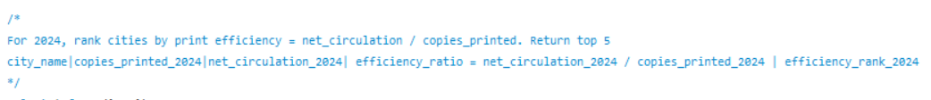
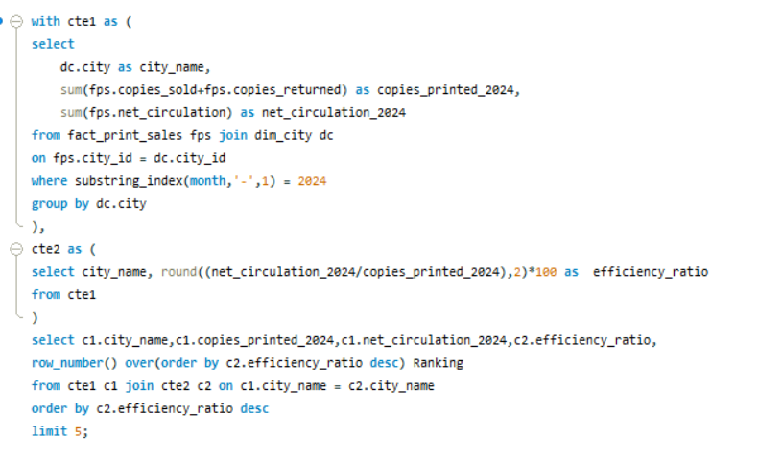
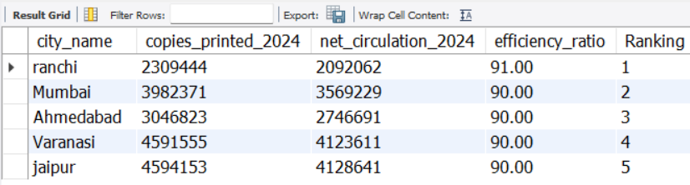
Business Request – 3

Slide 14
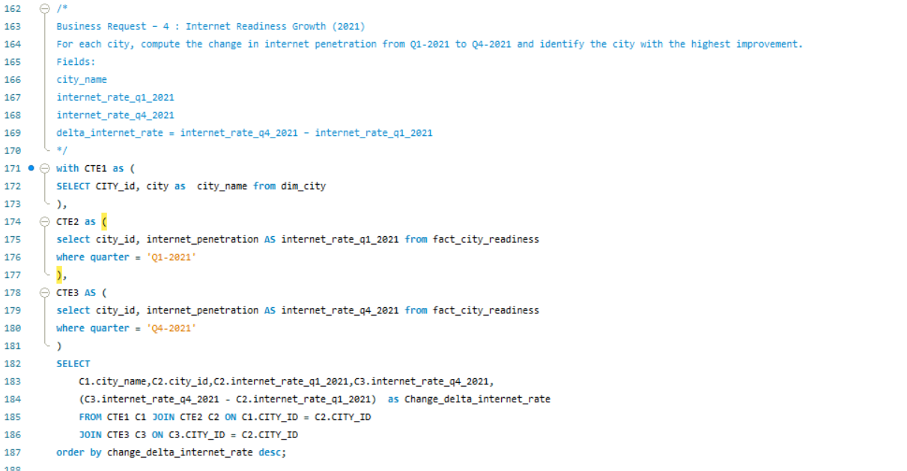
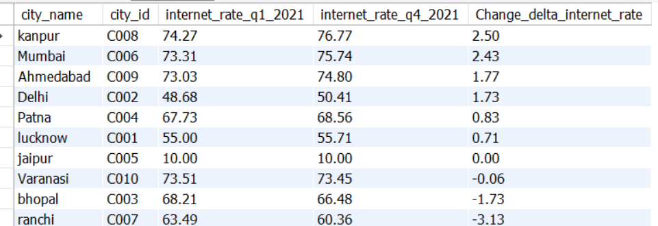
Business Request - 4

Slide 15
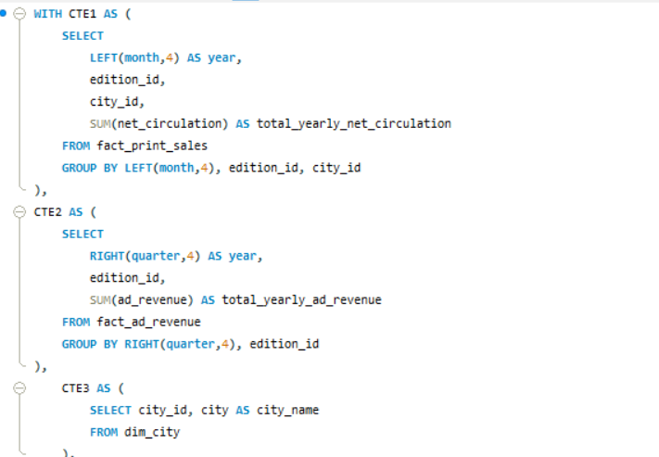
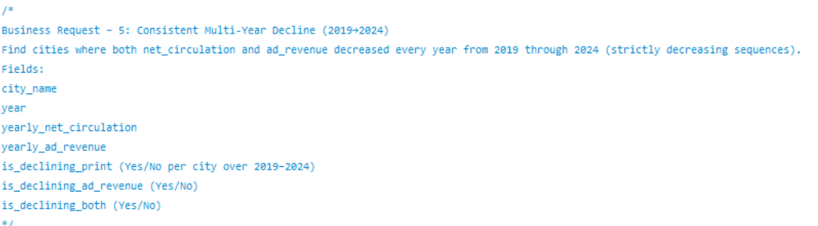
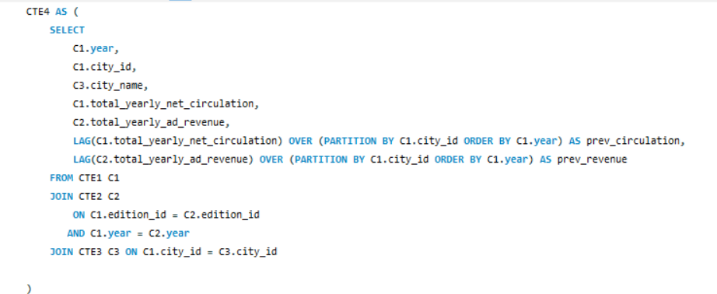
Business Request - 5

Slide 16
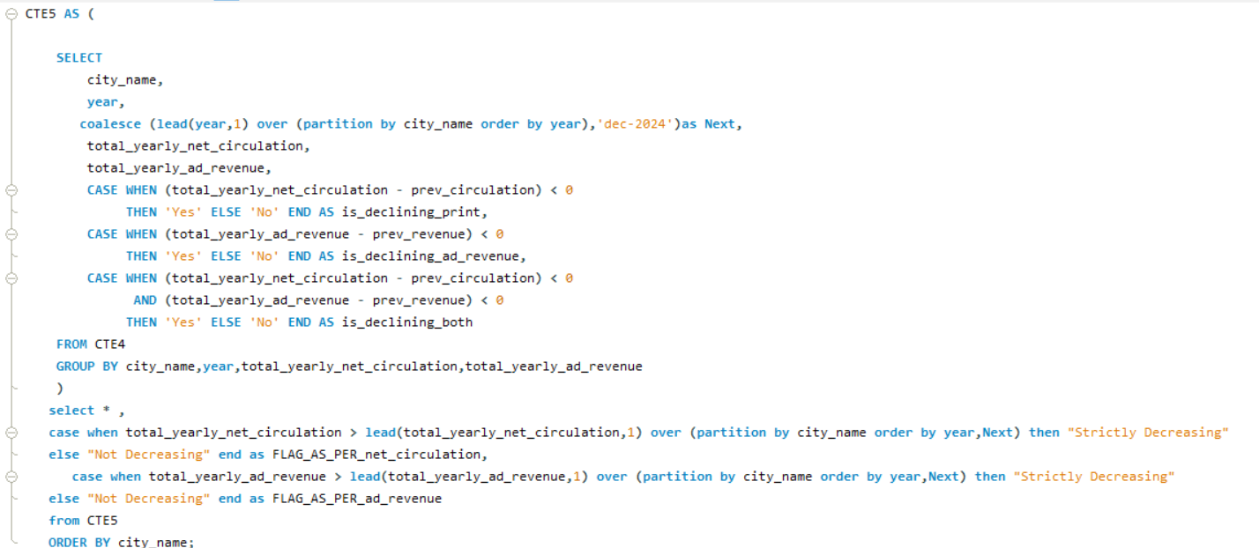
No city is there where net circulation and ad revenue both are declining together consecutive year. However, at least one year in every city breaks the chain.

Slide 17
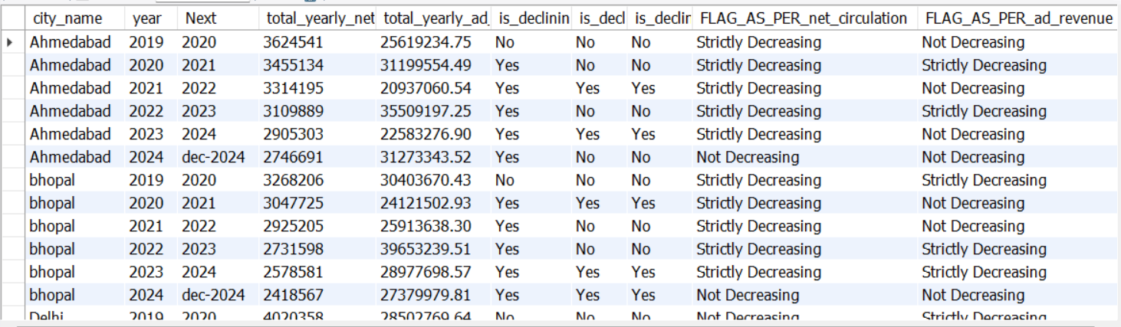
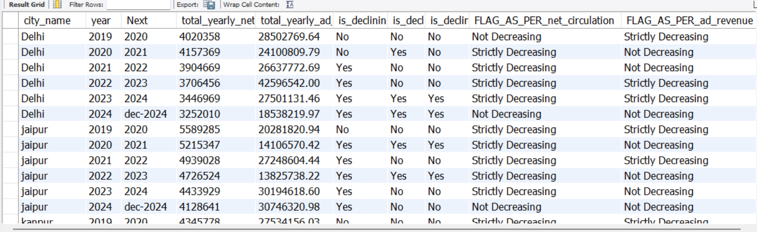

Slide 18
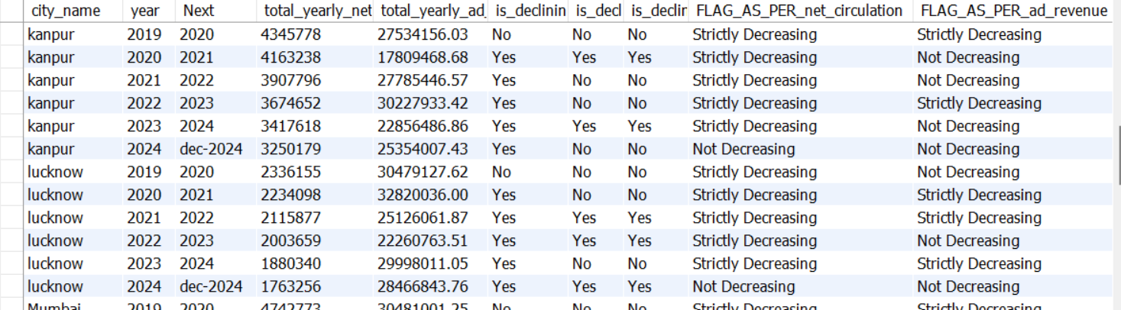
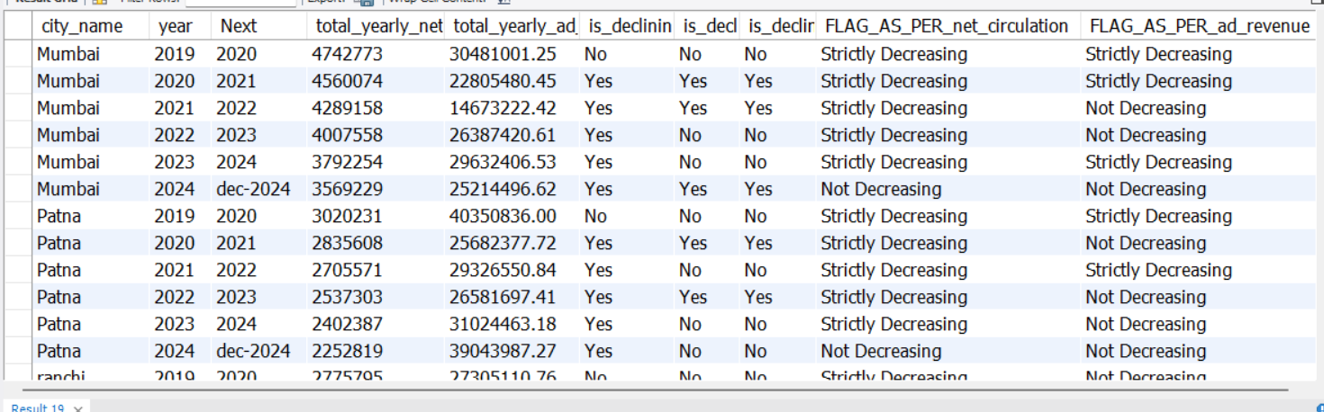

Slide 19
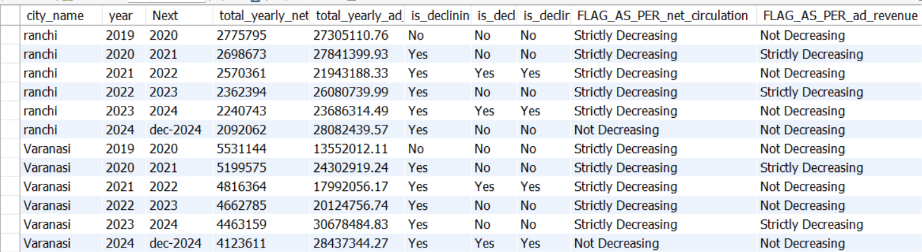

Slide 20
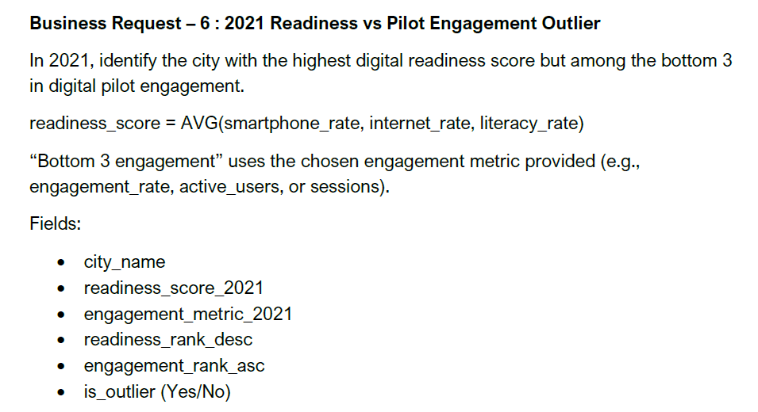

Slide 21
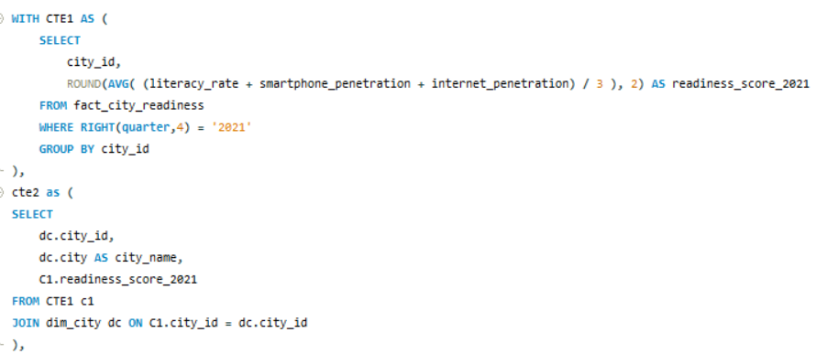
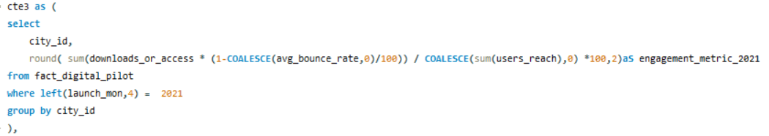
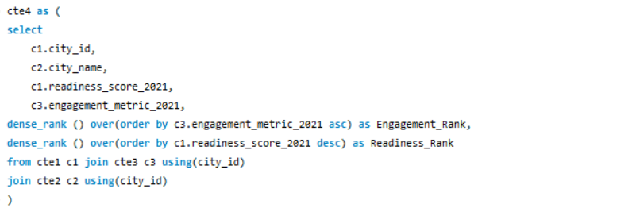

Slide 22
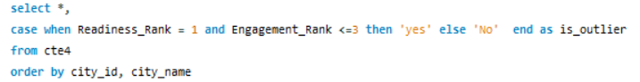
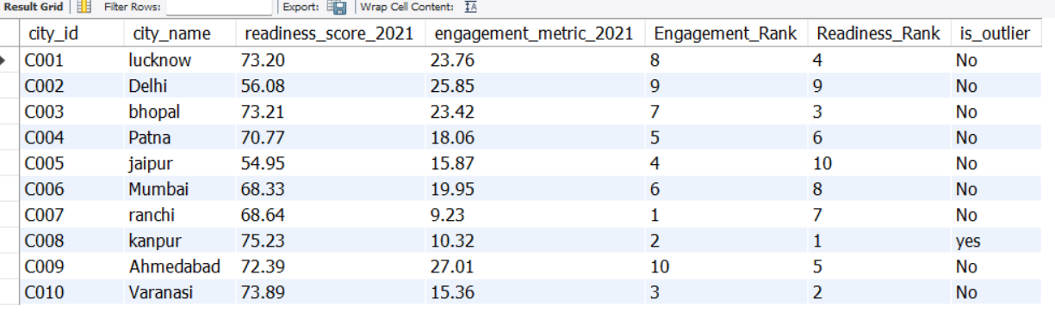
Kanpur (city_id = C008) is marked Yes. Readiness Rank = 1 (highest readiness).Engagement Rank = 2 (in bottom 3).

